Slide 1
Improving Preparedness of Communities for Evacuations using ZEVs
Development of ZEV Evacuation Readiness
Score - II
Presenter: Osman Saleem
December 5th, 2024

Slide 2
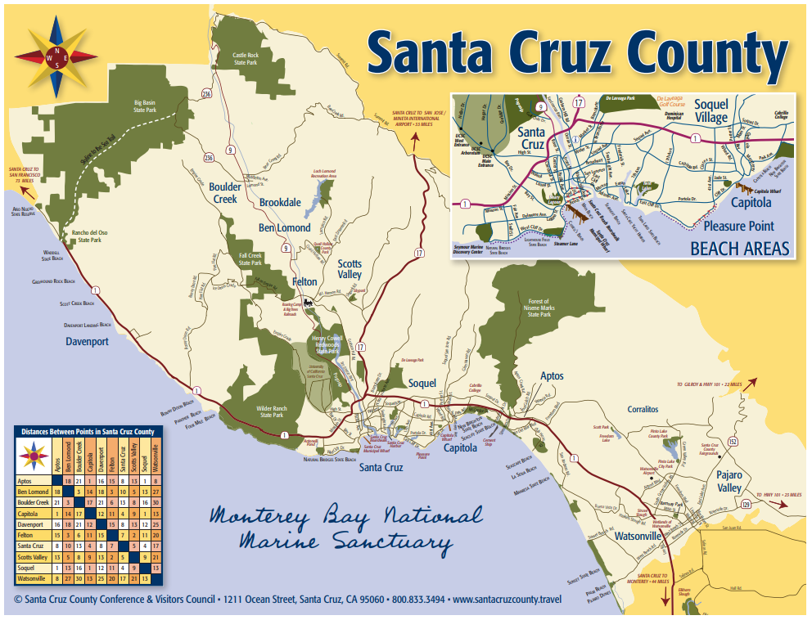
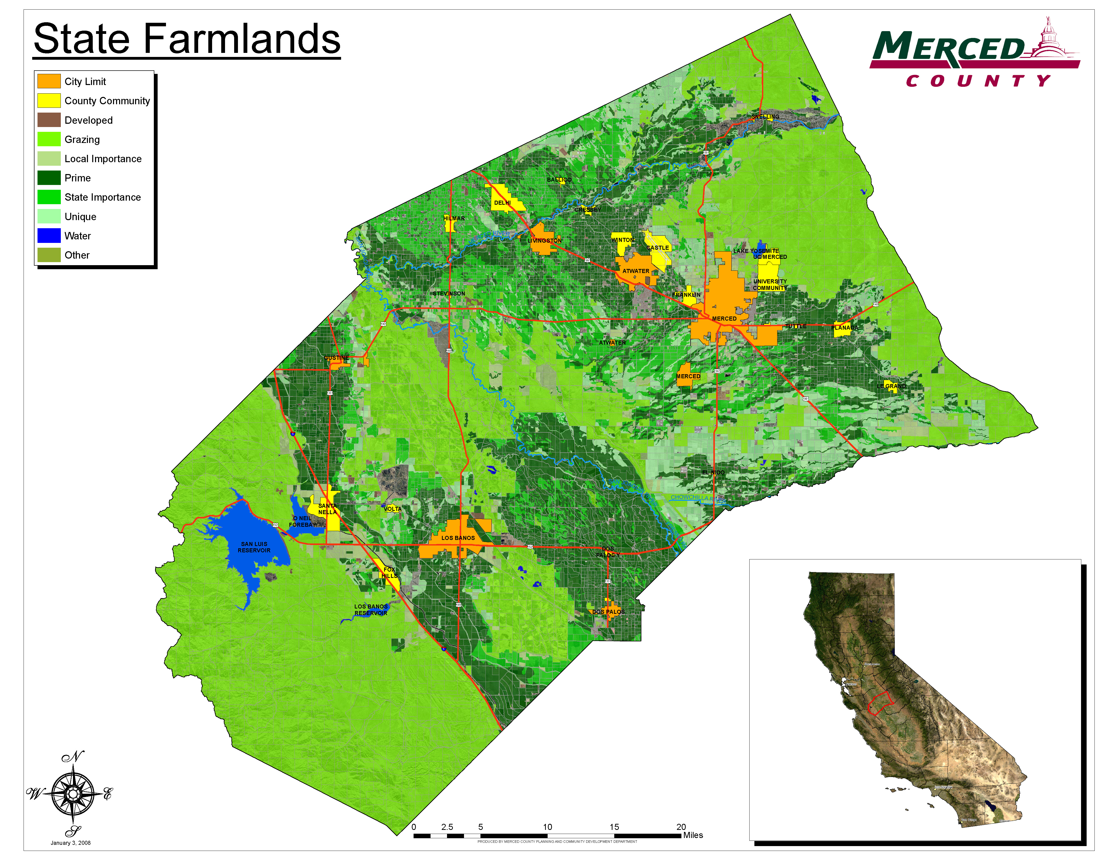



Intro to ZEV Evacuation Readiness Score
ZEV evacuation readiness score provides a basis to categorize each county based on its preparedness to successfully carry out a zero-emission vehicle evacuation.
ZEV Score:
ZEV Score:

Slide 3
ZEV Evacuation Readiness Score Framework
Use of Hazard maps
Exposure Analysis
Use of RGB analysis
Probability of a blackout
ZEV Evacuation Readiness Score
Infrastructure Vulnerability Assessment
Charging stations per vehicle
Road/Highway capacity
Evacuation Location/Distance
Adaptive Capacity of Infrastructure
Charging Stations Capacity to cope with huge influx
Backup/excess Generation of Electricity
Now, lets introduce the concept of weights!

Slide 4



ZEV Evacuation Readiness Score Weights Selection
Criteria
Criteria weights
0.5
Exposure Analysis
$$w_{1}$$
0.2
2
Final Score # 2= 3.5
Task
0.8
0.2
0.6
ZEV Evacuation Readiness Score
Infrastructure Vulnerability Assessment
$$w_{2}$$
+
Final score
0.3
0.9
1.5
Final Score # 1= 3.1
0.9
0.3
Adaptive Capacity of Infrastructure
$$w_{3}$$
where w1 represents the weight associated with the EI analysis, w2 represents the weight associated with the IVS analysis, w3 represents the weight associated with the ACIS analysis.
0.5
$$R\left(EI, IVS,ACIS\right)=EI . w_{1}+IVS . w_{2}+ACIS . w_{3}$$
But to present ZEV score 2.0, with new weights, we introduce a concept of fuzzification!

Slide 5
Fuzzification of Scoring Methodology
Why Fuzzification:
- Dealing with uncertainty
- Handling vagueness and ambiguity
- Improves decision making
- Help analyze real-world scenario better
Previously, we were using simple “Analytical Hierarchy Process”. But for ZEV Score 2.0 we will be using Fuzzification process.
Goal
ZEV Evacuation Readiness Score
Criterions
Exposure Analysis
Infrastructure Vulnerability Assessment
Adaptive Capacity of Infrastructure
Alternatives
. . . . .
Santa Cruz County
Merced County
Alameda County
Alpine County
. . . . .

Slide 6


Weights Comparison
Weights calculated using Fuzzified AHP
Weights calculated using simple AHP
$$w_{1}\left(for Exposure Analysis\right)=0.24$$
$$w_{1}\left(for Exposure Analysis\right)=0.15$$
$$w_{2}\left(for Infrastructure Vulnerability Analysis \right)=0.19$$
$$w_{2}\left(for Infrastructure Vulnerability Analysis \right)=0.2$$
$$w_{3}\left(for Adaptive Capacity Infrastructure \right)=0.668$$
$$w_{3}\left(for Adaptive Capacity Infrastructure \right)=0.65$$
Fuzzified Analytical Hierarchy Process (FAHP) enhances the standard Analytical Hierarchy Process (AHP) by incorporating fuzziness, which provides a more nuanced and accurate decision-making framework.

Slide 7

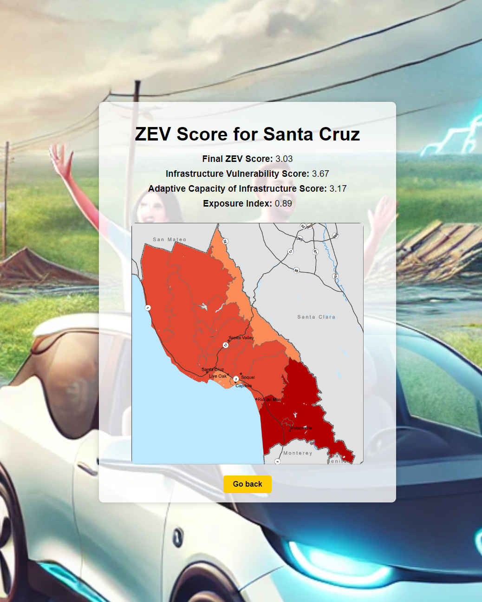
Creation of ZEV Calculation Tool
Landing Page
Result Page

Slide 8


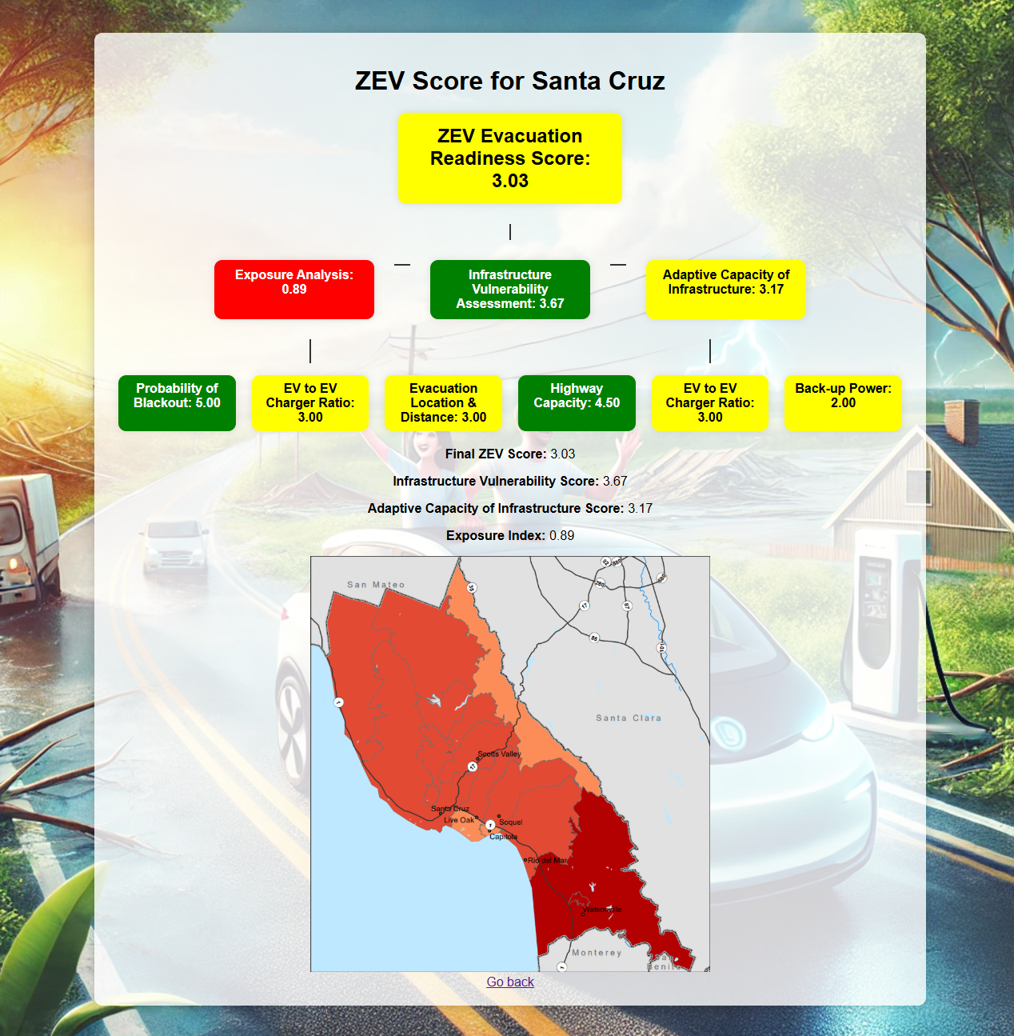



ZEV Score Calculation Web Page Development
Contains the scoring methodology, takes input from the user and gives a ZEV score.
Backend
Requirements.txt & Procfile for the configuration purposes.
Image folder keeping the exposure index map for each county that can be selected for drop down menu.
These files are used to design the landing and resulting page.
Frontend

Slide 9
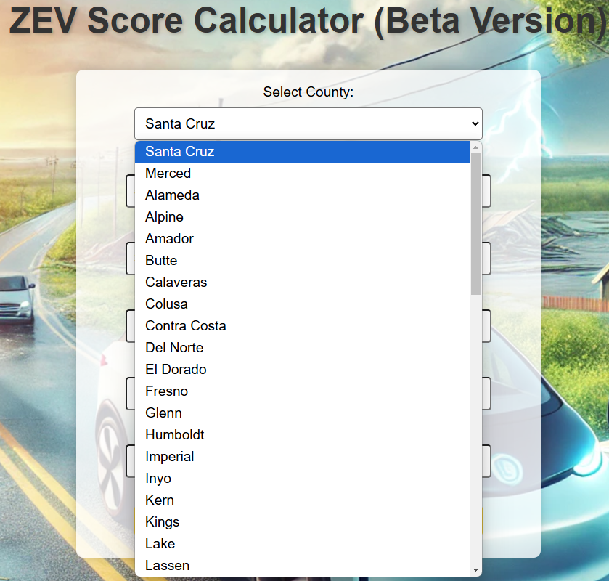
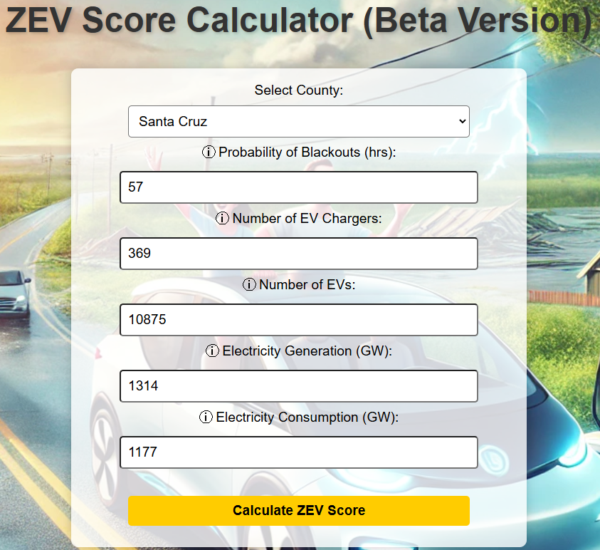
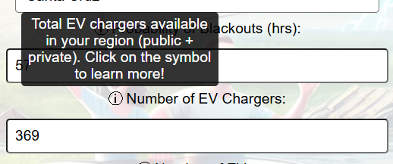
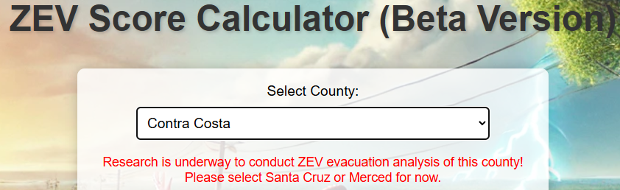
ZEV Score Calculation Web Page Key Features
Contains every county in the drop-down menu.
Whenever a County is selected, criteria values will automatically be adjusted for that county.
There is an information symbol right beside each criteria which can redirect you to further resources.
Right now, website is not optimized for counties except for Santa Cruz and Merced!

Slide 10
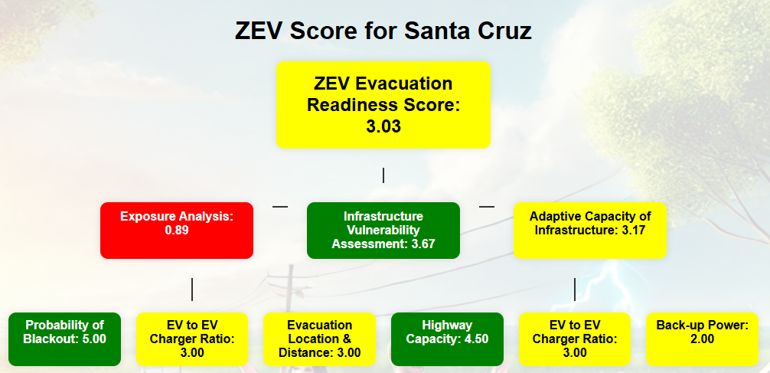

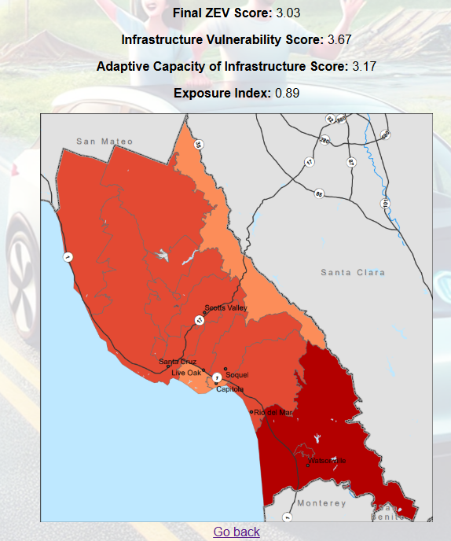



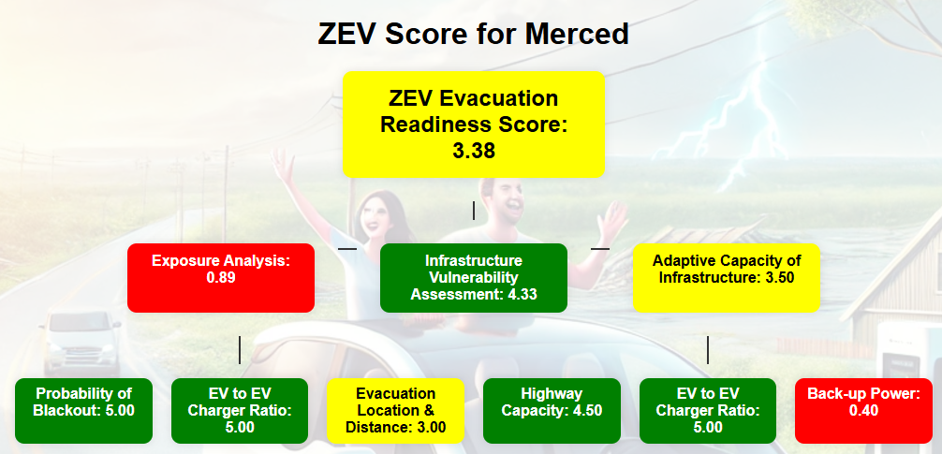

ZEV Score Calculation Web Page Key Features
Output is represented in a flowchart for easier understanding of key factors enhancing or reducing the ZEV score.
Color coordination is introduced to better highlight the criteria/sub-criteria that need attention/improvement.
When exposure analysis is being carried out in runtime, the map being used is also displayed at the result page.
Resources used for Merced hazard analysis: https://thinkhazard.org/en/report/28888-united-states-of-america-california-merced

Slide 11

Link to the Website!
https://zevscorecalculator-6a334960ec96.herokuapp.com/

Slide 12

Thank you!

